Slide 1
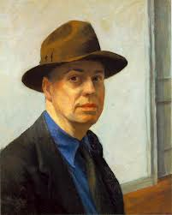
Edward Hopper
American Realism
1882-1967
Mrs Caumartin (Clg Maupassant, Houilles)

Slide 2
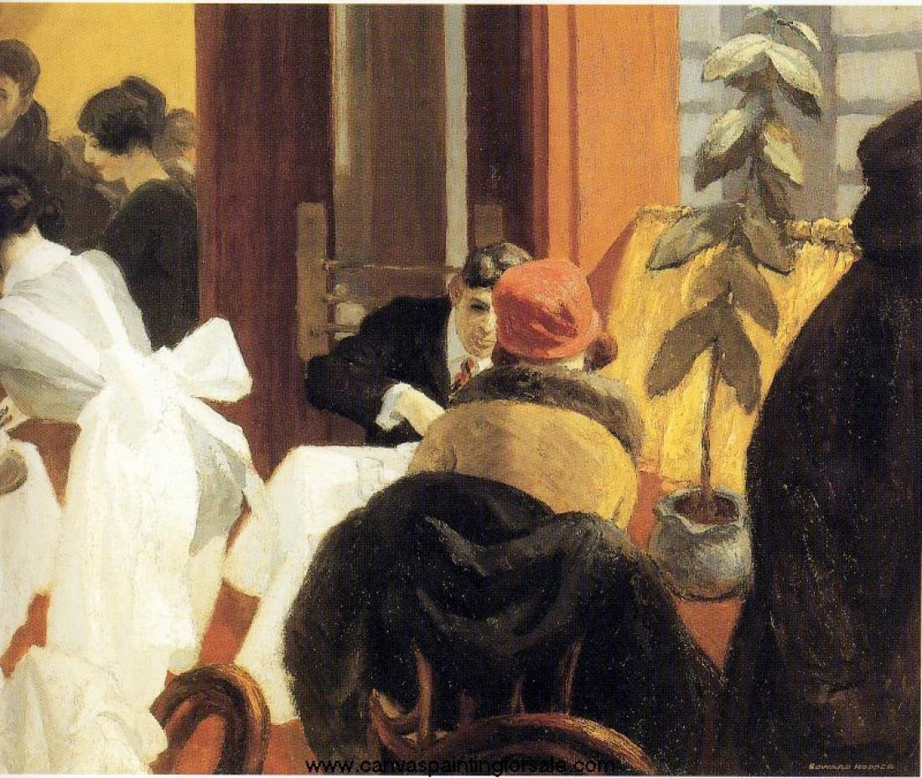
New York restaurant, 1922

Slide 3
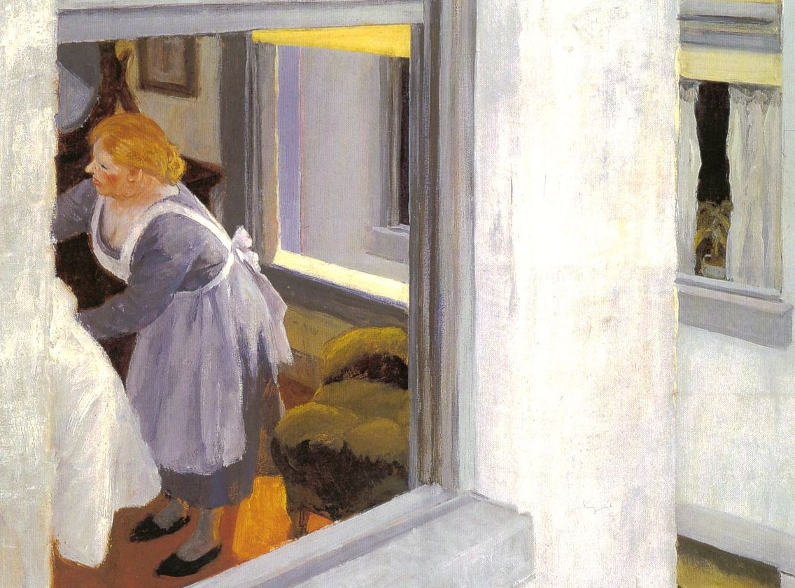
Apartment Houses, 1923

Slide 4
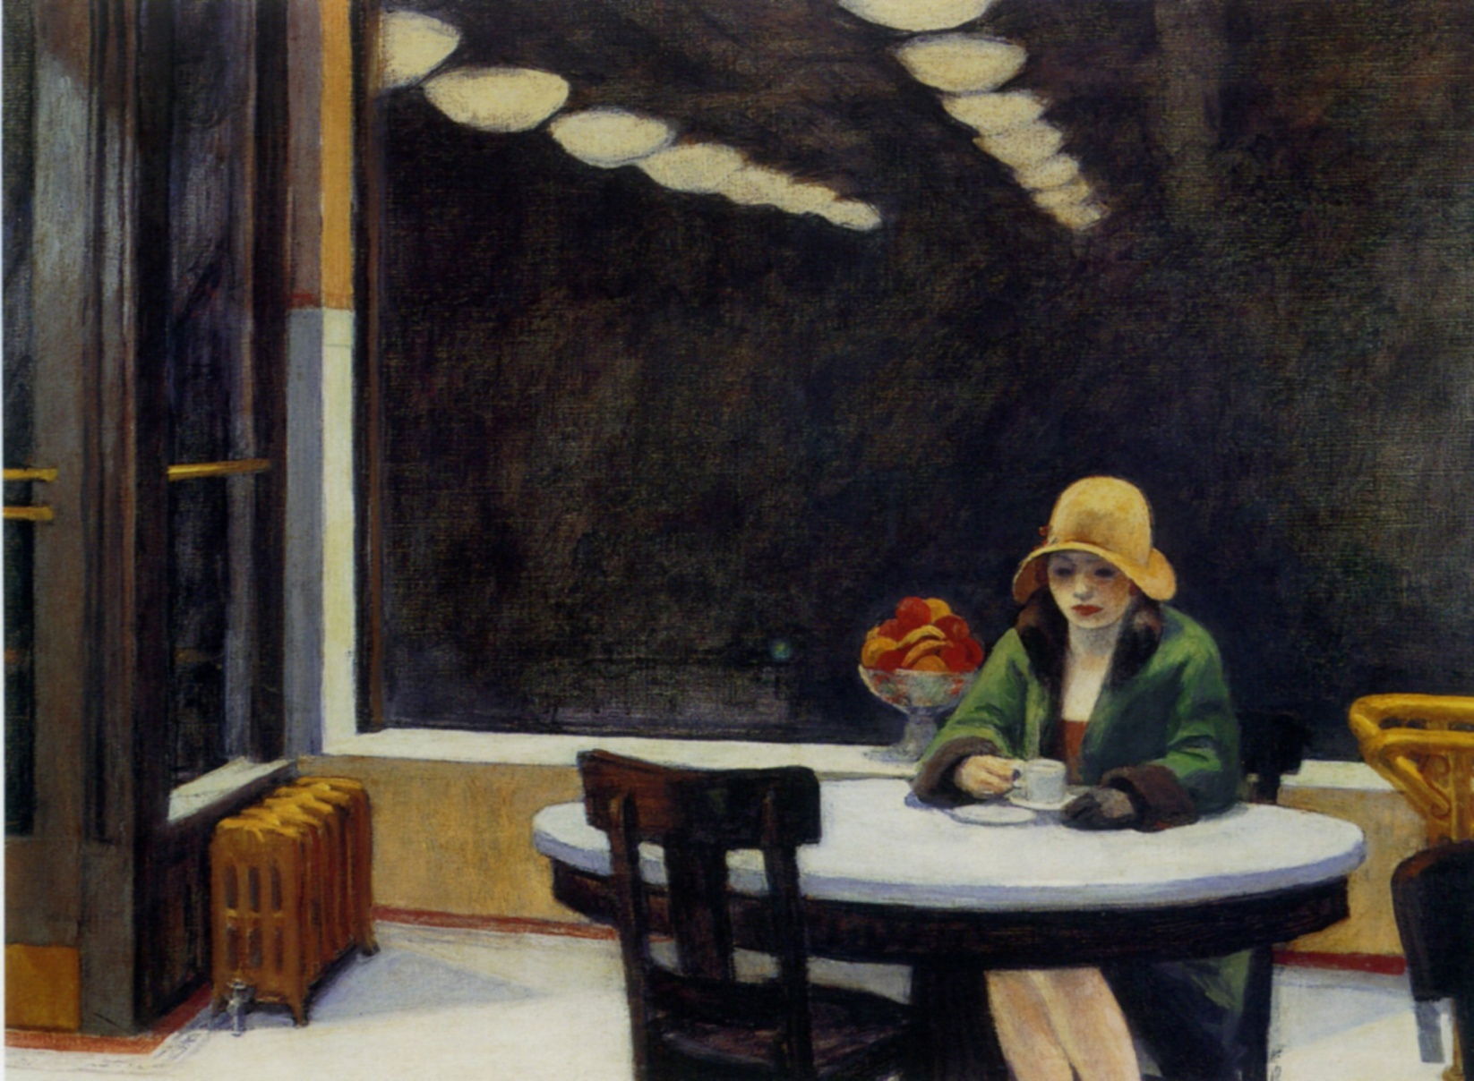
Automat, 1927

Slide 5
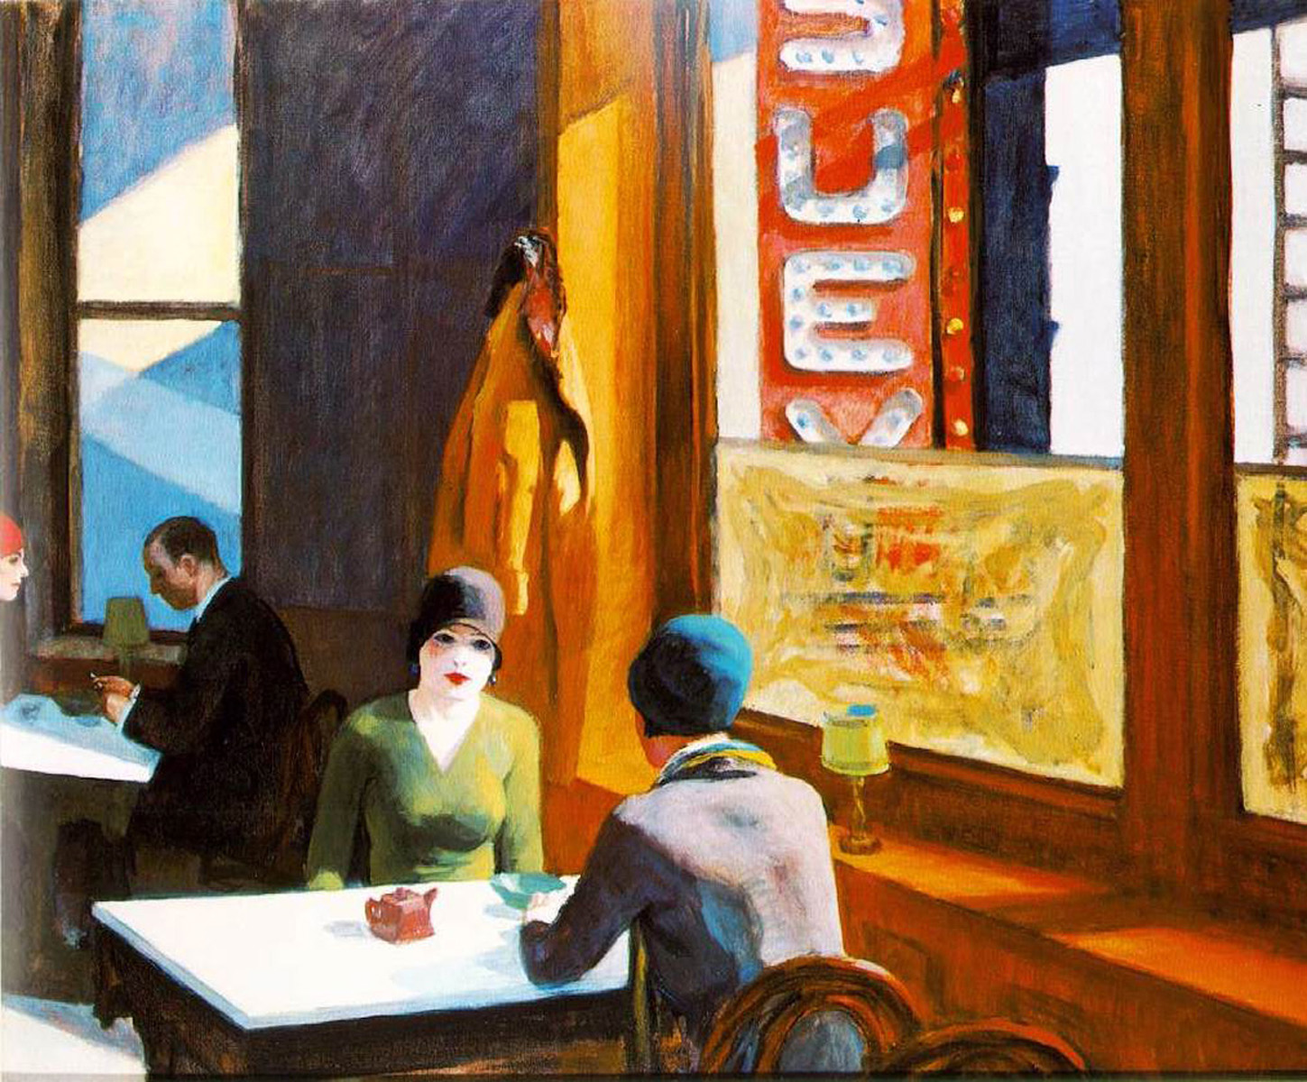
Chop suey, 1929

Slide 6
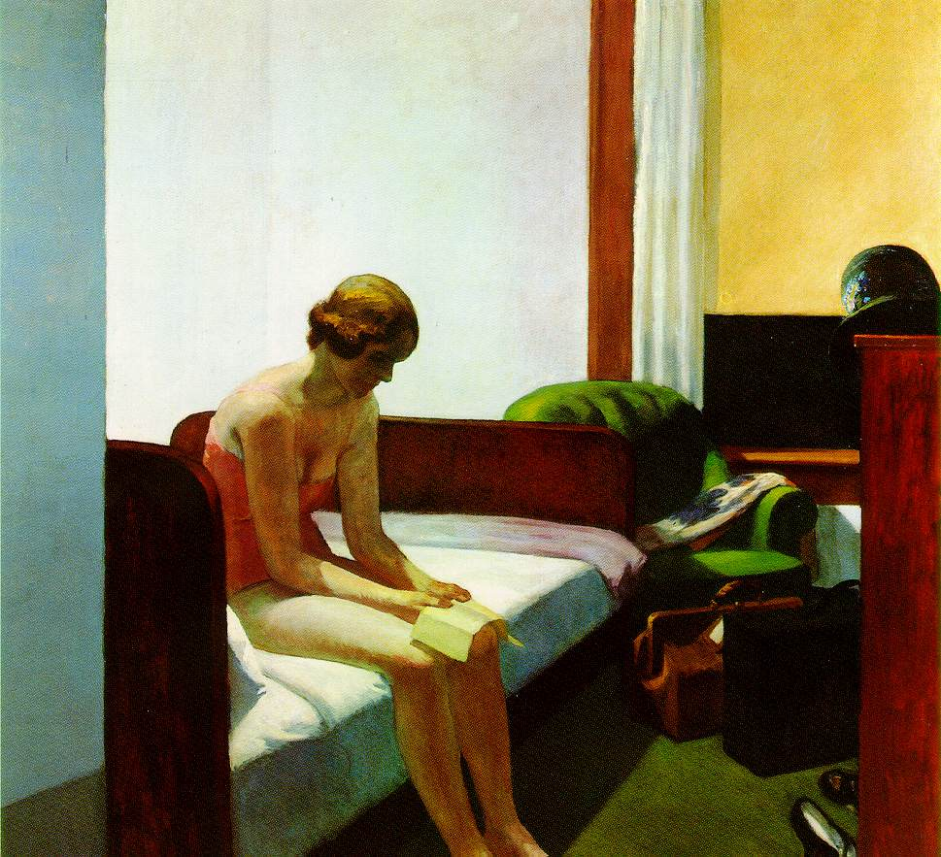
Hotel room, 1931

Slide 7
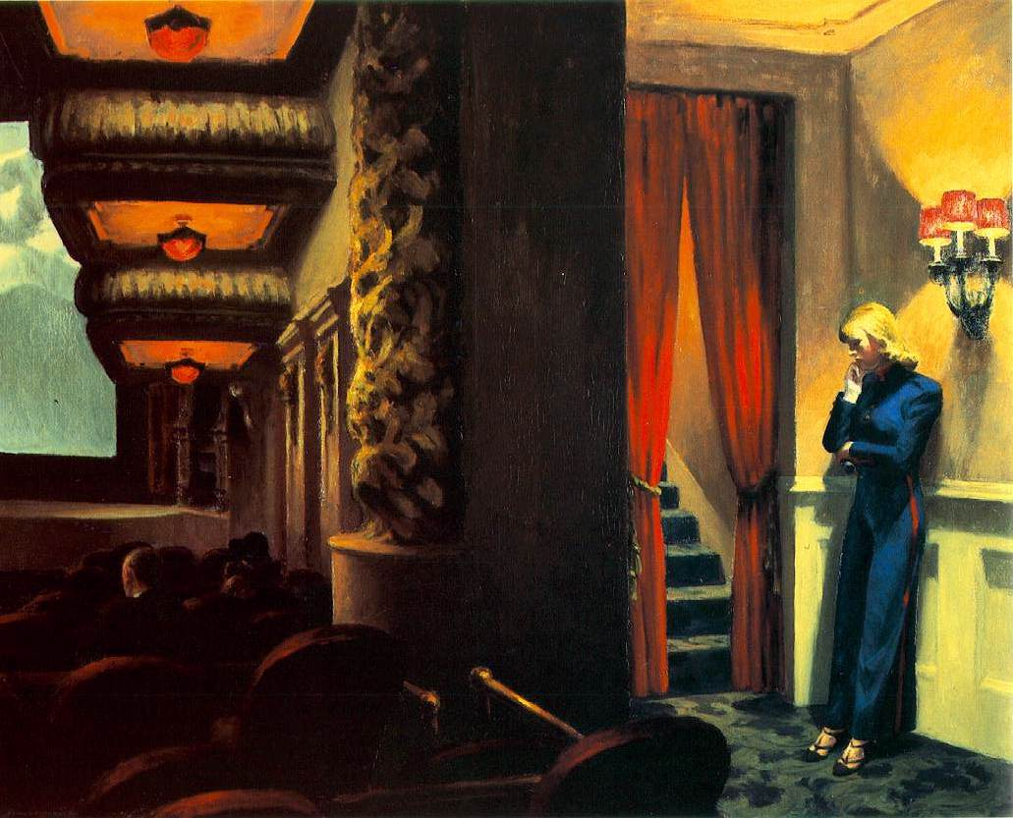
New York movie, 1939

Slide 8
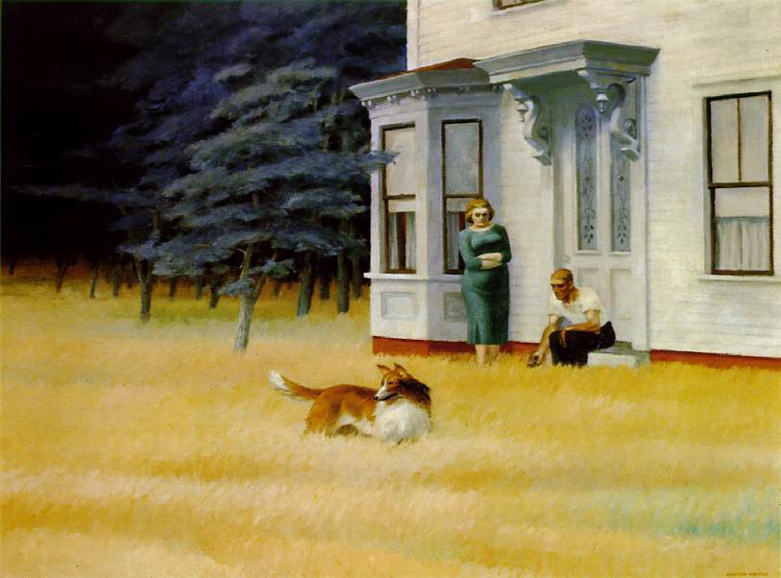
Cape Cod evening, 1939

Slide 9
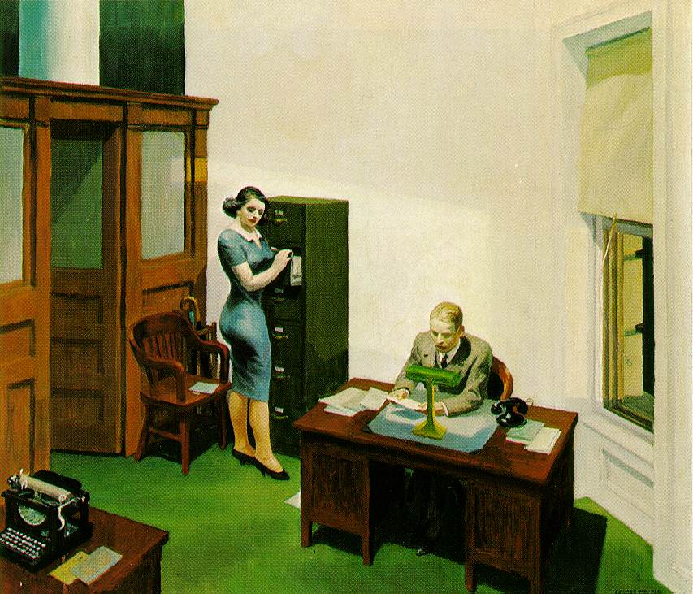
Office at night, 1940

Slide 10
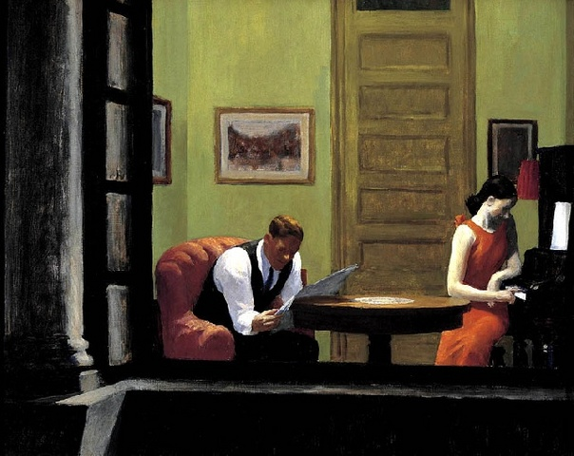
Room in New York, 1940

Slide 11
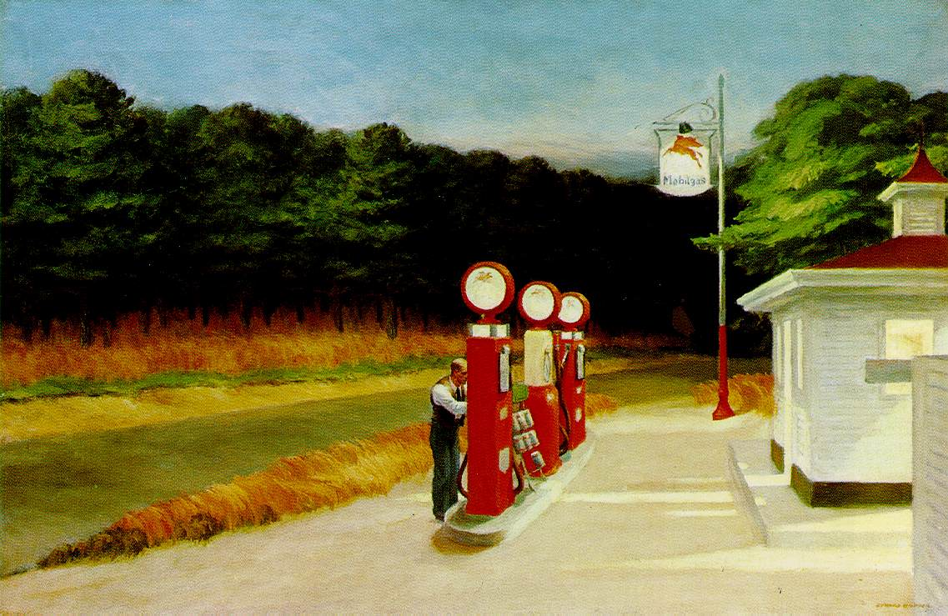
Gas, 1940

Slide 12
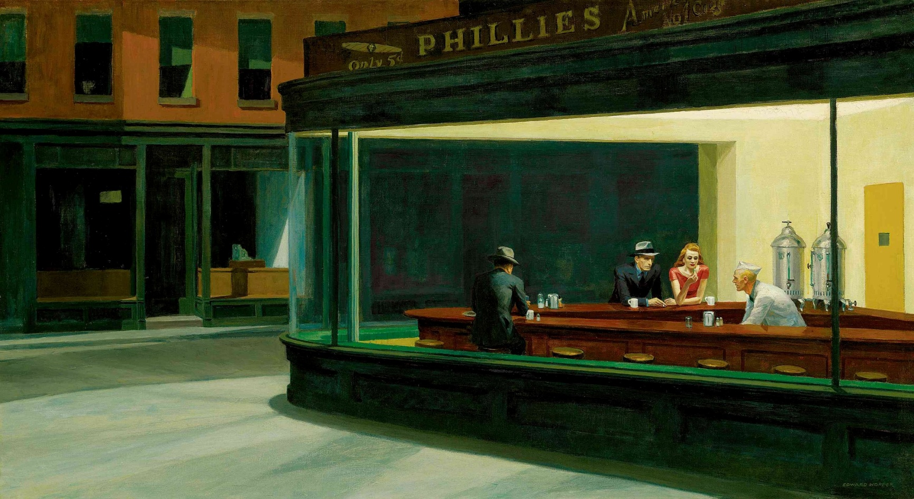
Nighthawks, 1942

Slide 13
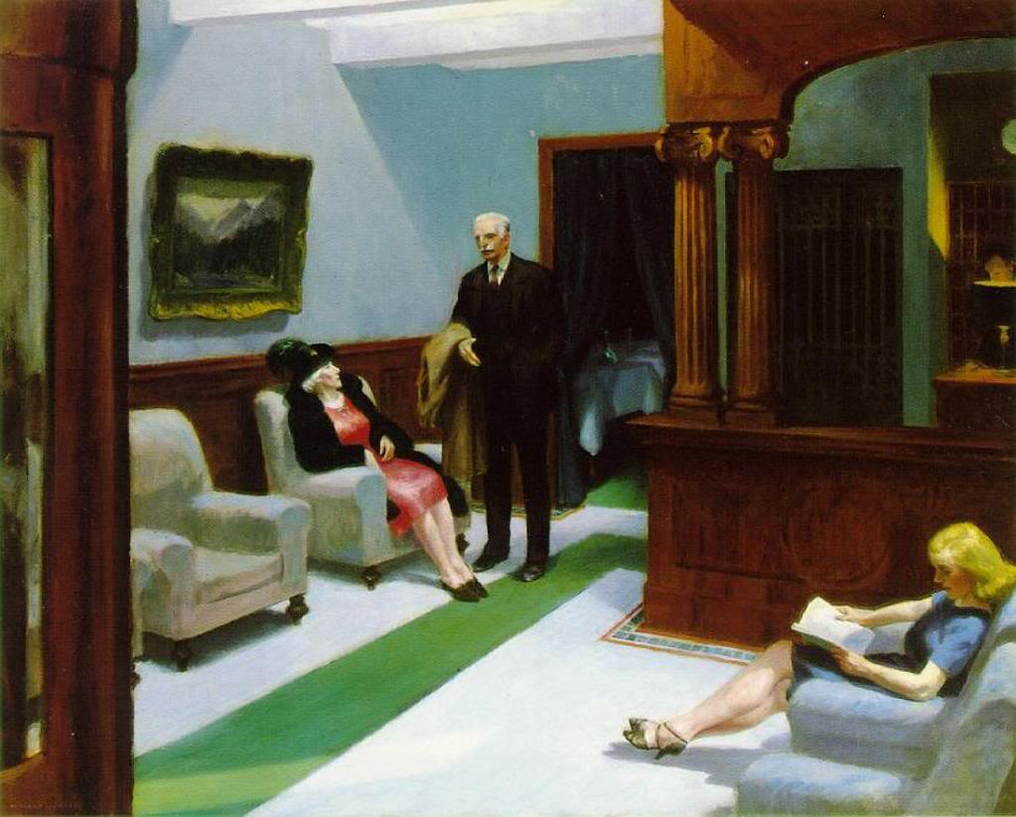
Hotel Lobby, 1943

Slide 14
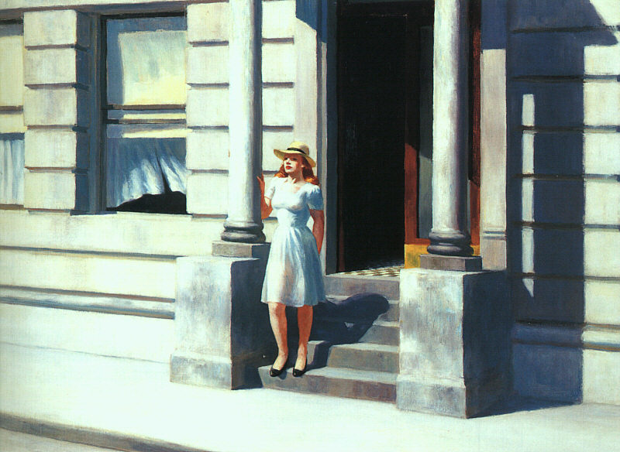
Summertime, 1943

Slide 15
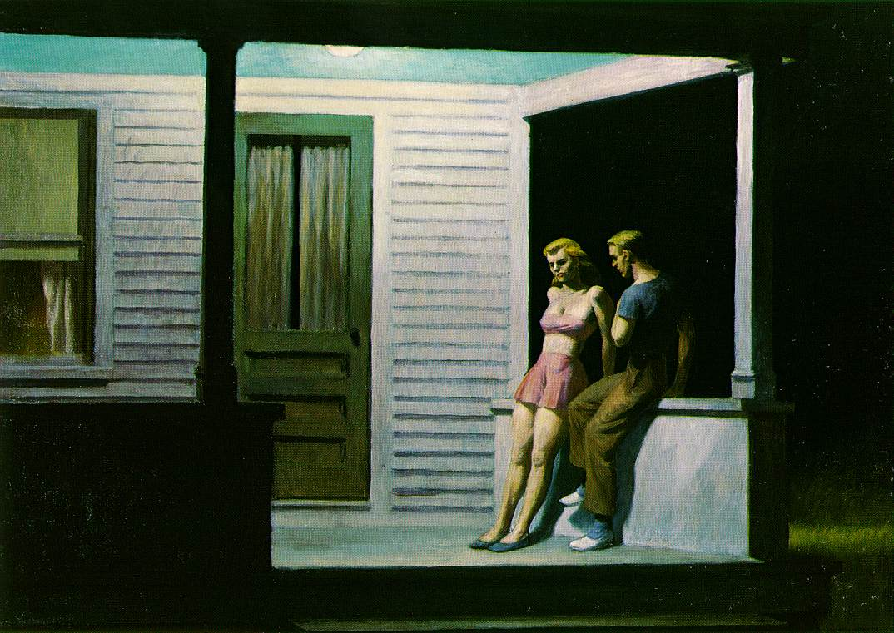
Summer evening, 1947

Slide 16
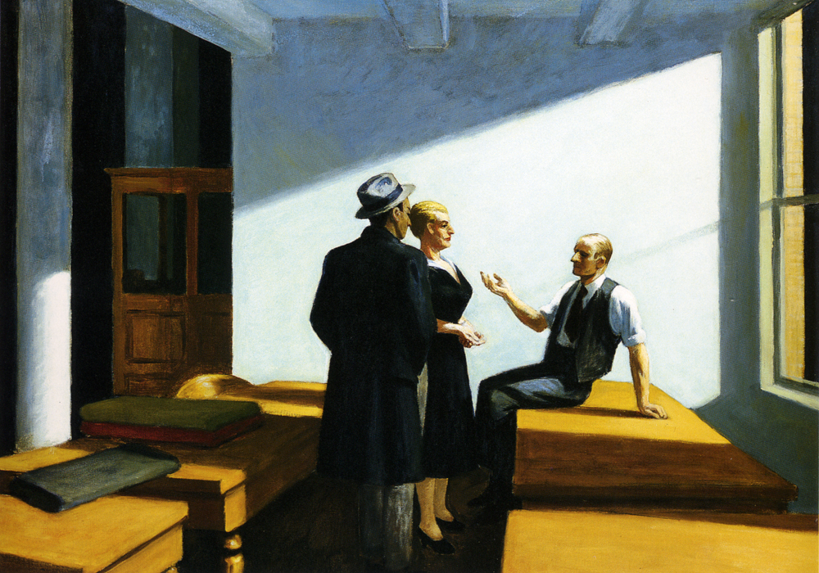
Conference at night, 1949

Slide 17
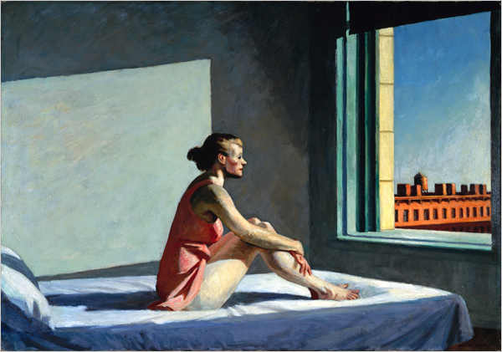
Morning sun, 1952

Slide 18
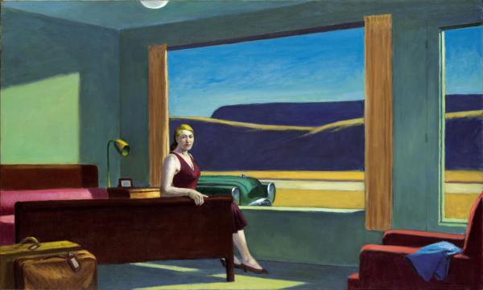
Western Motel, 1957

Slide 19
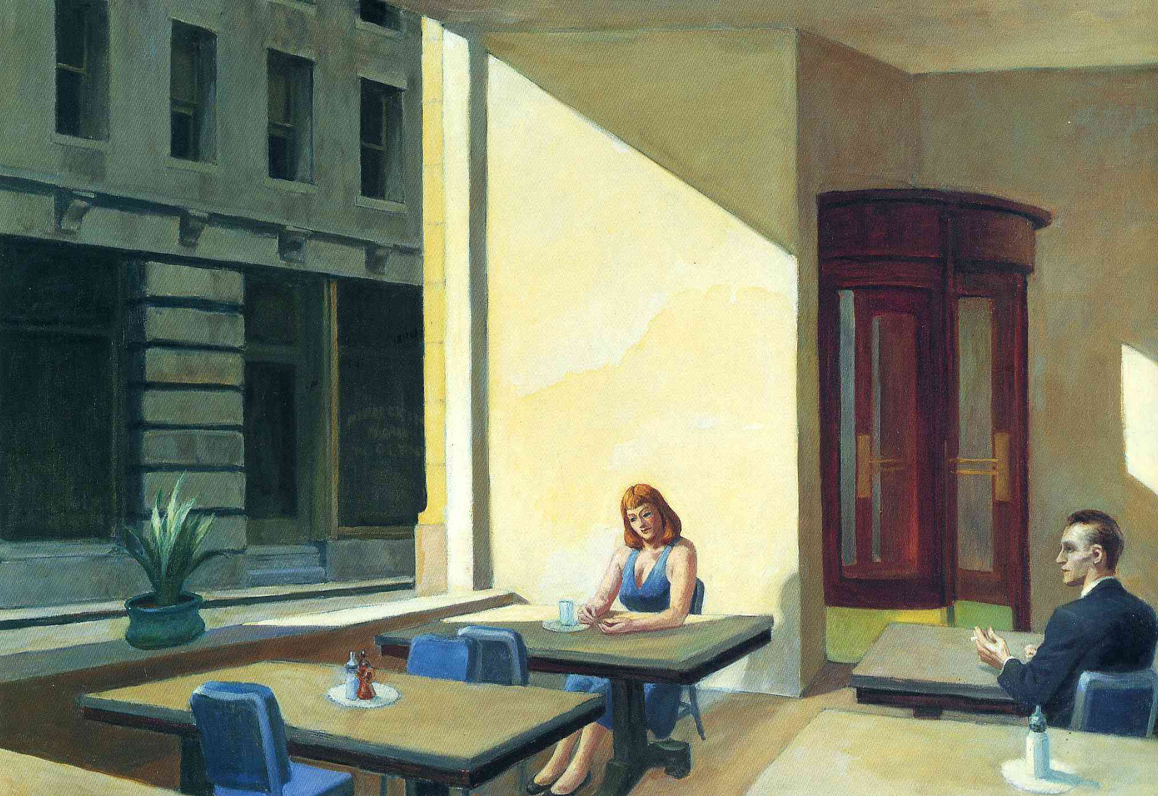
Sunlight in a cafeteria, 1958

Slide 20
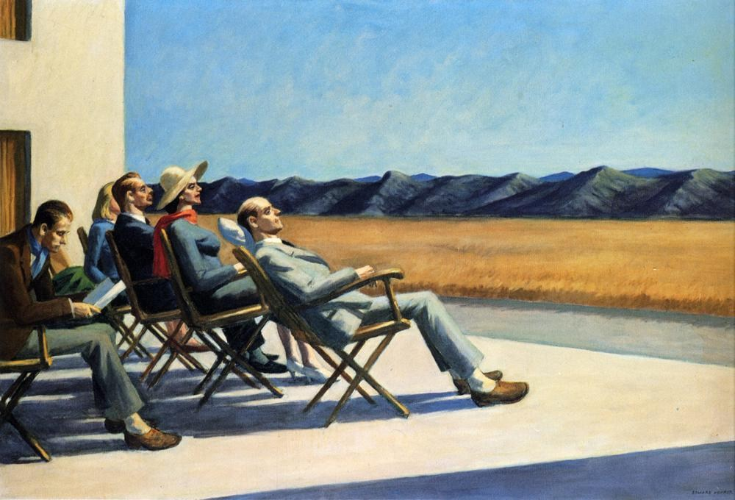
People in the sun, 1960

Slide 21
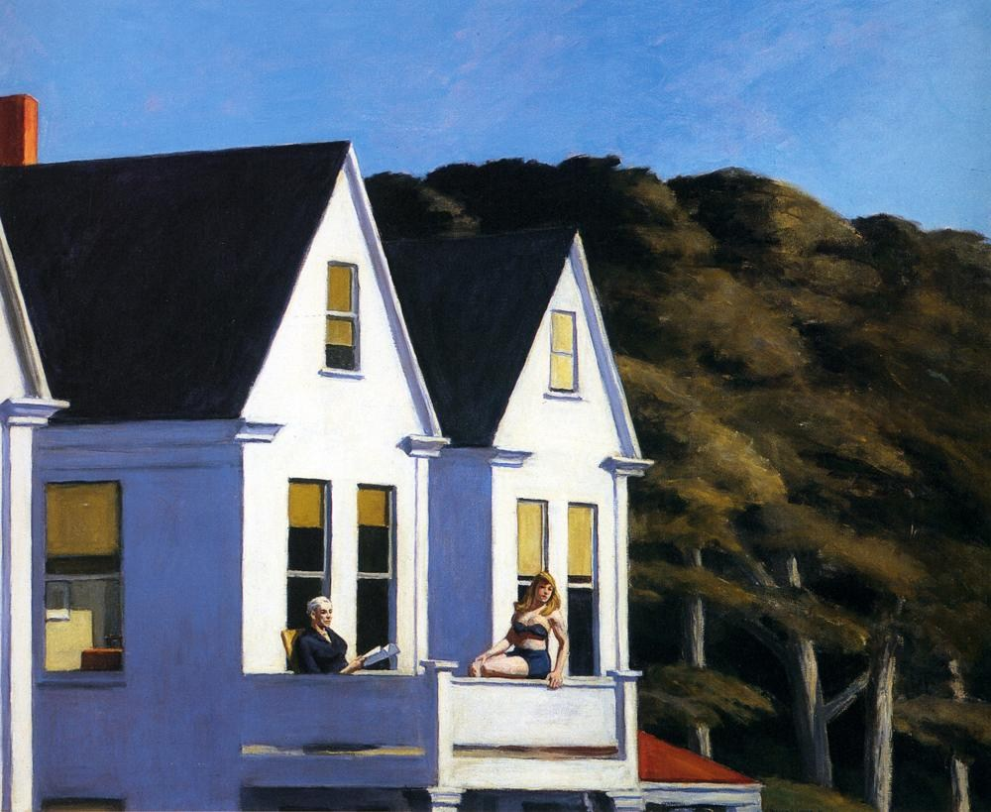
Second Story Sunlight, 1960

