Slide 1
INSTRUCTIONS

Slide 2
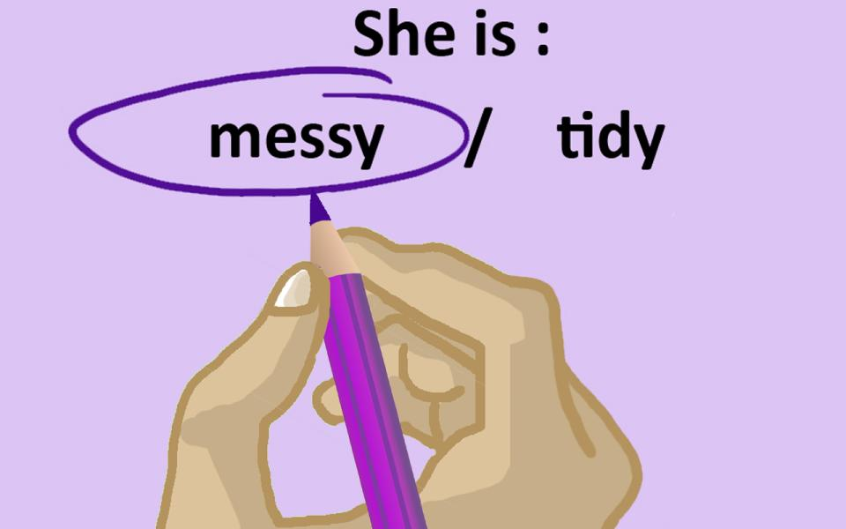
Circle!

Slide 3

Complete!

Slide 4

Highlight!

Slide 5

Match!

Slide 6

Tick!

Slide 7

Underline!

Slide 8
MATHIEU CindyCollège Jean Vilar (Grigny) et collège Eugène Delacroix (Draveil)
Académie de Versailles
diddy2703@hotmail.com

