Slide 1
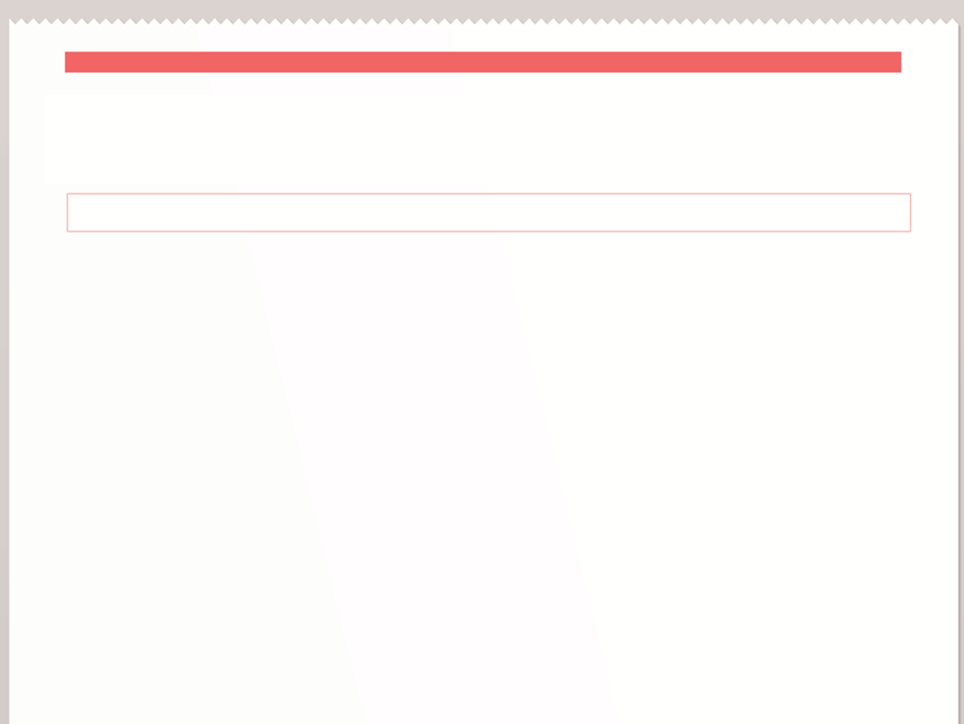

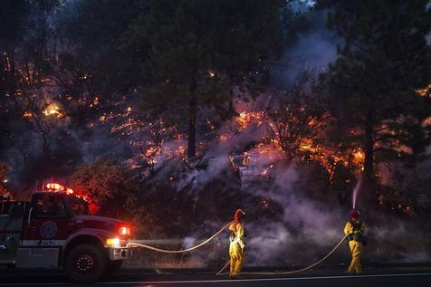
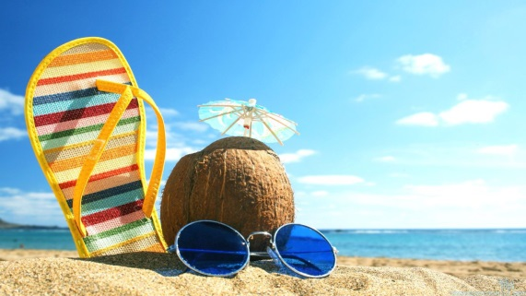
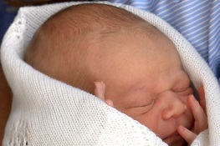

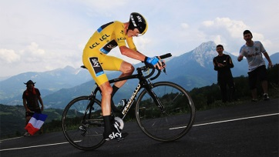
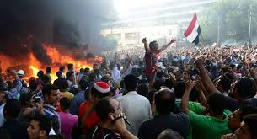
THE DAILY NEWS
www.dailynews.com
THE WORLD’S FAVOURITE NEWSPAPER
SEPTEMBER
Summer in Review

Slide 2
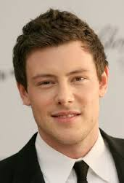
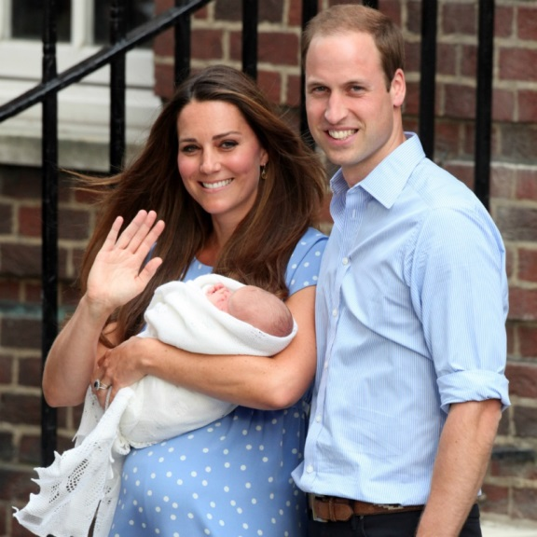
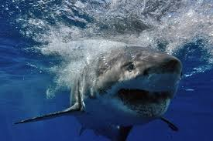
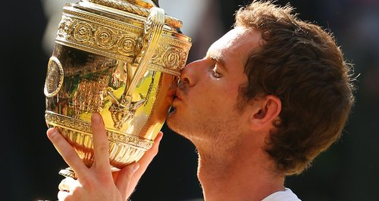
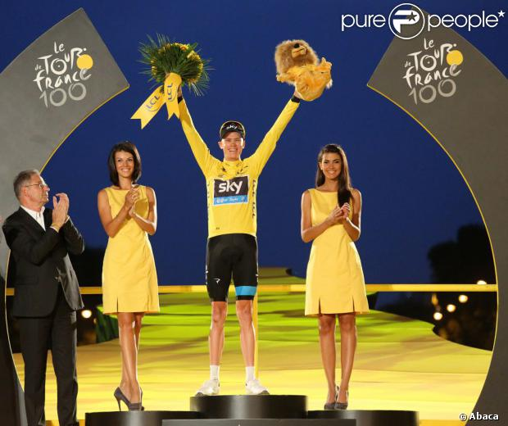
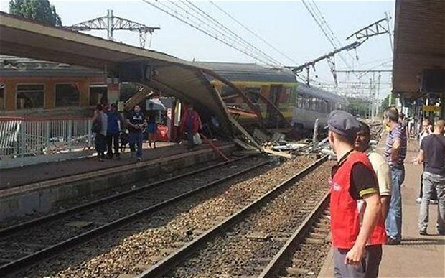
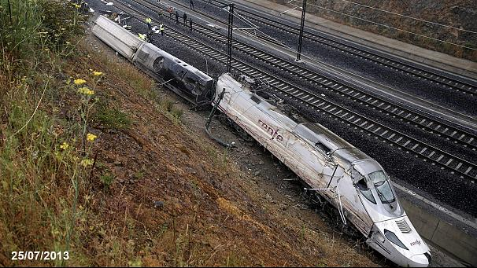
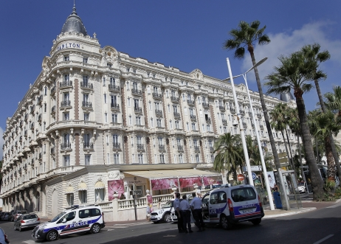
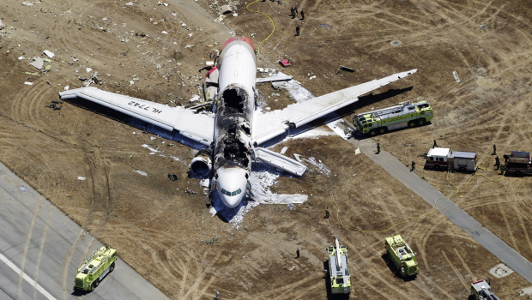
What happened in July ?

Slide 3
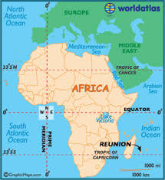
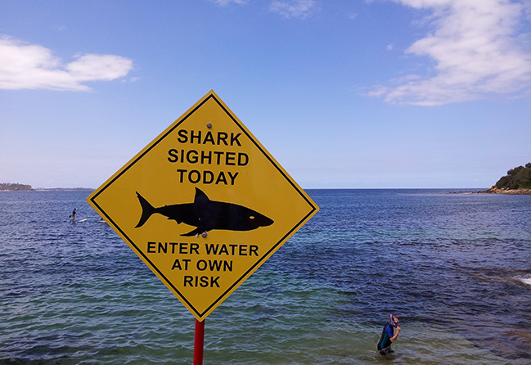
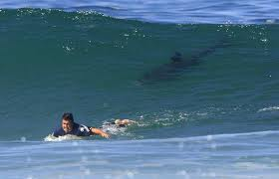

Slide 4
THE DAILY NEWS
www.dailynews.com
THE WORLD’S FAVOURITE NEWSPAPER
JULY 15th
Title ?
Deadly Attack On Reunion Island
A shark attacked a 15-year-old girl while she was swimming just meters from the shore of Reunion Island. The teenage girl died.
attack
die

Slide 5

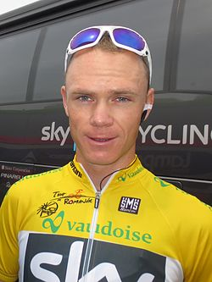


Slide 6
THE DAILY NEWS
www.dailynews.com
THE WORLD’S FAVOURITE NEWSPAPER
JULY 21st
Title?
British Champion!
Chris Froome, aged 28, won the 100th edition of the Tour de France. He became the second British cyclist to win the tour de France.
win
become

Slide 7


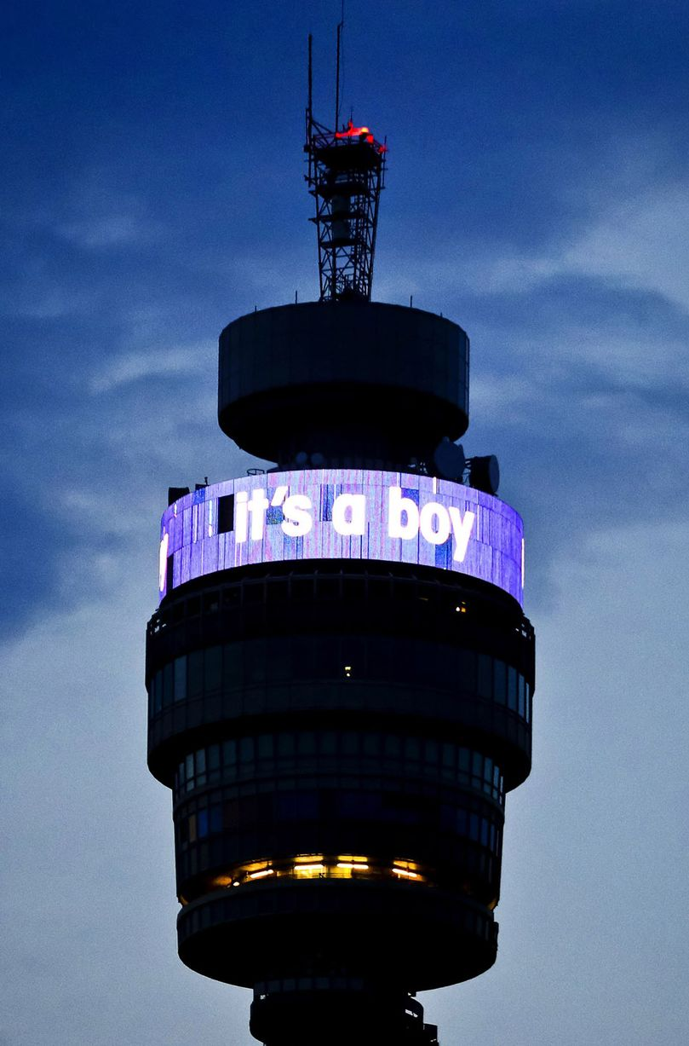

Slide 8
THE DAILY NEWS
www.dailynews.com
THE WORLD’S FAVOURITE NEWSPAPER
JULY 22nd
Royal Baby
Title?
The Duchess of Cambridge gave birth to a baby boy. Two days later, the world knew the baby’s name: George Alexander Louis.
give
know

Slide 9
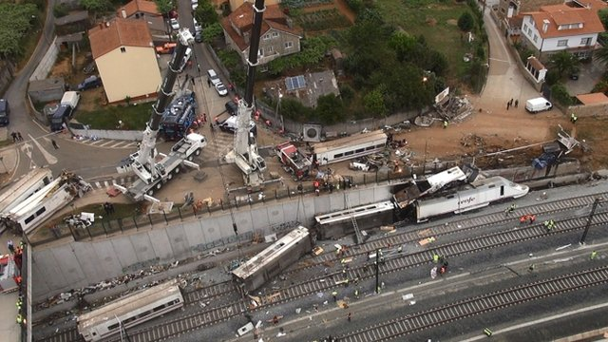
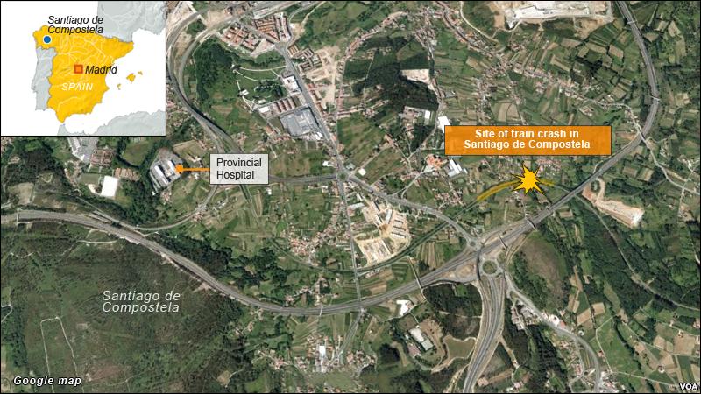
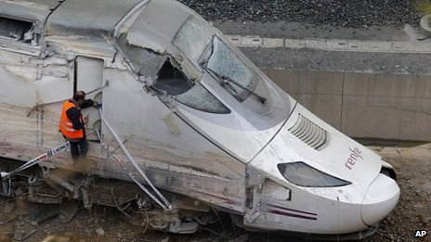

Slide 10
THE DAILY NEWS
www.dailynews.com
THE WORLD’S FAVOURITE NEWSPAPER
JULY 26th
Train Crash
Title ?
A high-speed train crashed and derailed in Santiago de Compostella. It killed 79 people.
The driver was arrested
and accused of “reckless homicide”.
crash
derail
kill
be

Slide 11
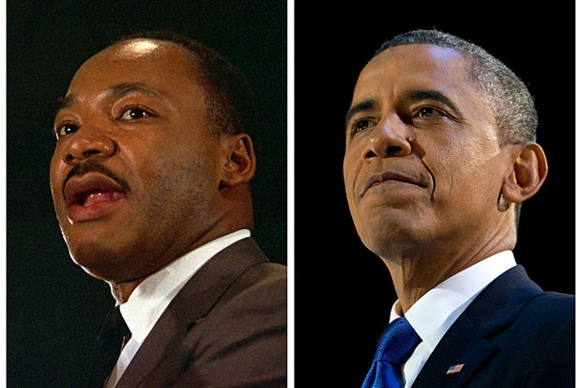
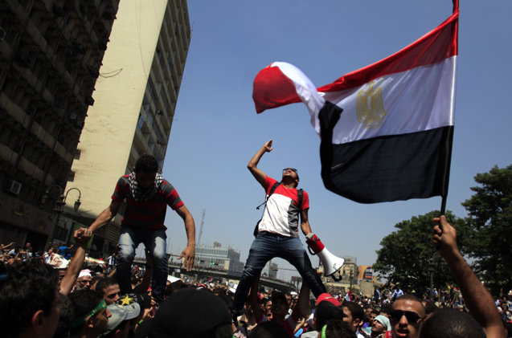
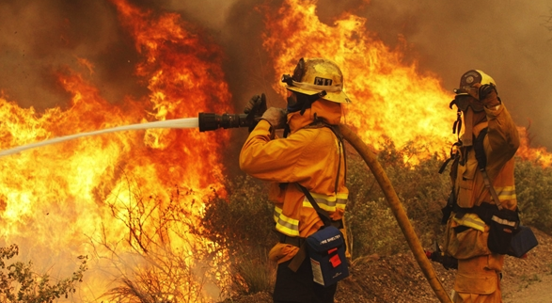
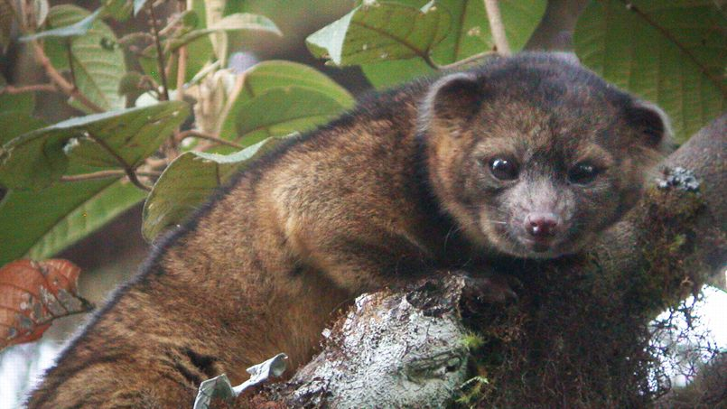
What happened in August ?

Slide 12
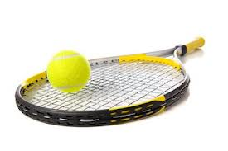

Slide 13
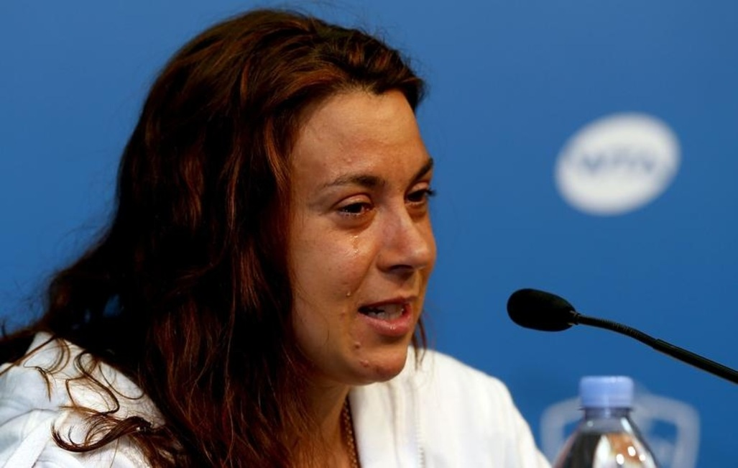
THE DAILY NEWS
www.dailynews.com
THE WORLD’S FAVOURITE NEWSPAPER
AUGUST 14th
Last Match of her Career
Title ?
announce
Marion Bartoldi announced she retired from tennis at the age of 28, less than 6 weeks after winning Wimbledon. She said she hurt herself too often and did not want to continue.
retire
say
hurt
do

Slide 14
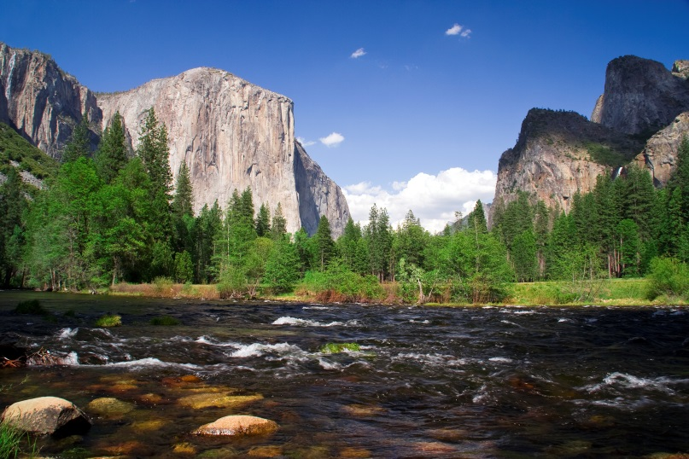
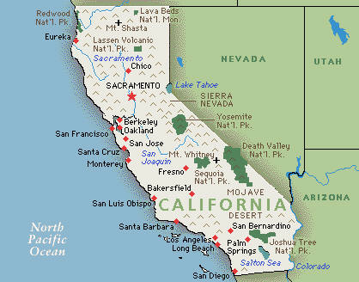
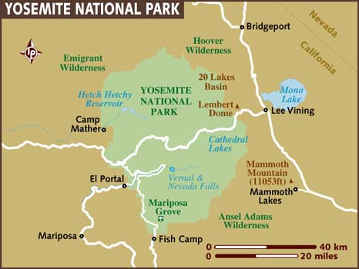

Slide 15
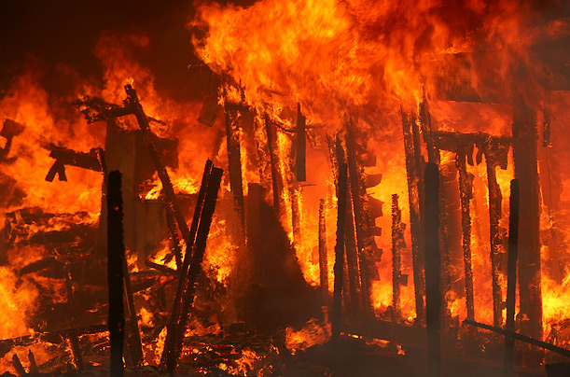
THE DAILY NEWS
www.dailynews.com
THE WORLD’S FAVOURITE NEWSPAPER
AUGUST 17th
Massive Fire in California
Title ?
In California, a huge wildfire invaded Yosemite National Park. More than 2600 firefighters fought the blaze. The giant sequoia trees burnt in the park.
invade
fight
burn

Slide 16
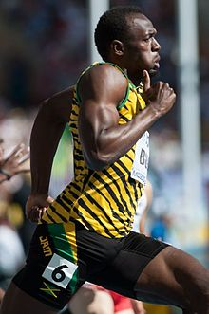
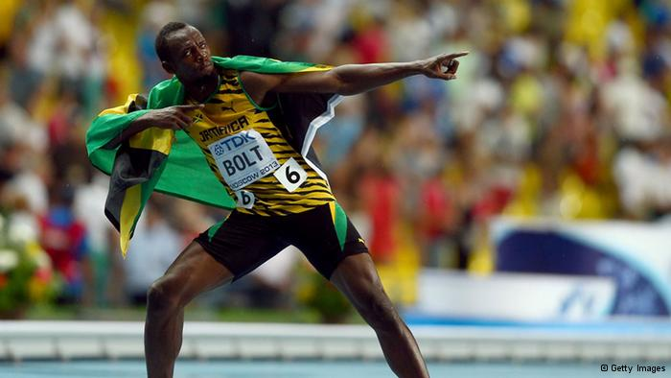

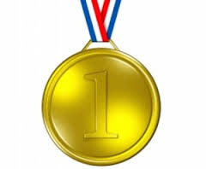

Slide 17
THE DAILY NEWS
www.dailynews.com
THE WORLD’S FAVOURITE NEWSPAPER
AUGUST 18th
Most Successful Athlete in History
Title ?
From August 10th to August 18th, the World Athletics Championships took place in Moscow. Usain Bolt got three gold medals in 100m, 200m and 4x100m relay.
take
get

Slide 18
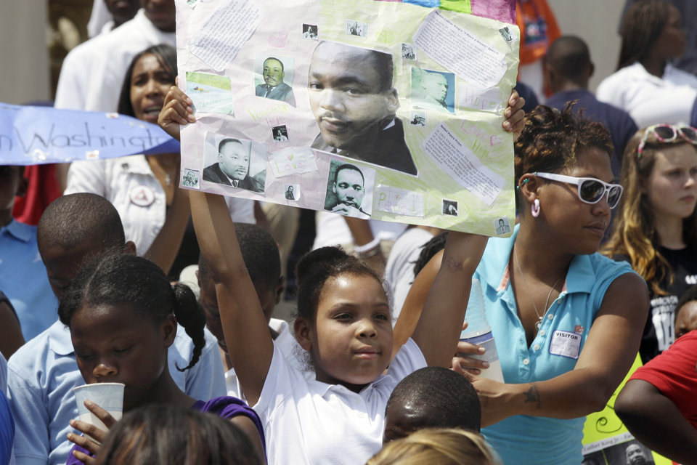
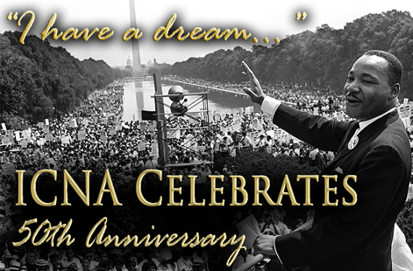
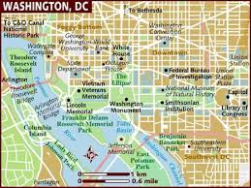

Slide 19
THE DAILY NEWS
www.dailynews.com
THE WORLD’S FAVOURITE NEWSPAPER
AUGUST 28th
“I Have a Dream”
Title ?
Thousands of people gathered at the Lincoln Memorial in Washington to celebrate the 50th anniversary of Martin Luther King’s famous speech. They watched and listened to Barack Obama.
gather
watch
listen

Slide 20
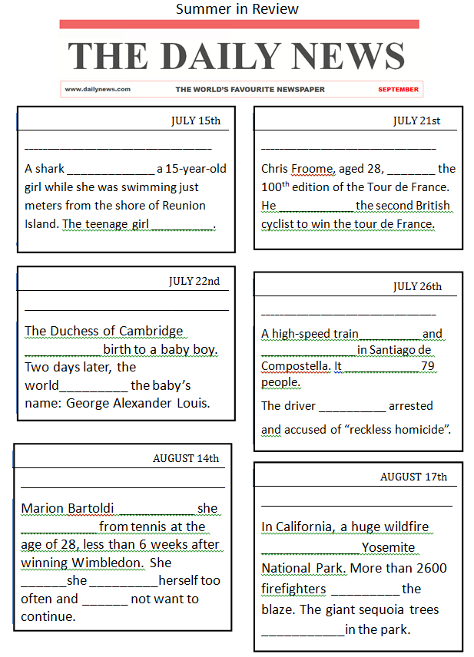
Reunion Island
France
Deadly Attack on Reunion Island
British Champion !
attacked
won
was
died
England
Spain
Royal Baby
Train Crash
crashed
gave
derailed
killed
knew
was
England
Last Match of Her Career
The Usa
announced
Massive Fire in California
retired
invaded
said
hurt
fought
did
burnt

Slide 21
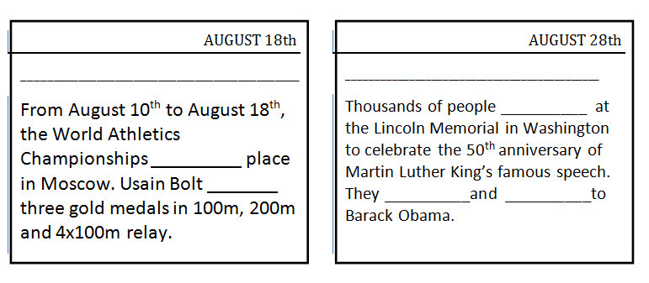
Russia
The USA
Most Successful Athlete in History
“I Have a Dream”
gathered
took
got
watched
listened

Slide 22

Think about it :
Quel temps vas tu utiliser ? _____________________
Pourquoi ? _________________________________
Formes possibles du verbe à la forme affirmative:
____________verbs: _________________________
____________verbs: _________________________
Le prétérit
Actions passées, datées, terminées
regular
B.V. + « ED »
irregular
Il faut les apprendre par cœur (2eme colonne dans la liste des verbes irréguliers)

Slide 23
INFINITIVE | PAST | PAST PARTICIPLE | TRANSLATION
WIN WON WON GAGNER
BECOME BECAME BECOME DEVENIR
GIVE GAVE GIVEN DONNER
KNOW KNEW KNOWN CONNAITRE
BE WAS/WERE BEEN ETRE
SAY SAID SAID DIRE
HURT HURT HURT BLESSER
DO DID DONE FAIRE
FIGHT FOUGHT FOUGHT COMBATTRE
BURN BURNT BURNT BRULER
TAKE TOOK TAKEN PRENDRE
GET GOT GOT OBTENIR

Slide 24
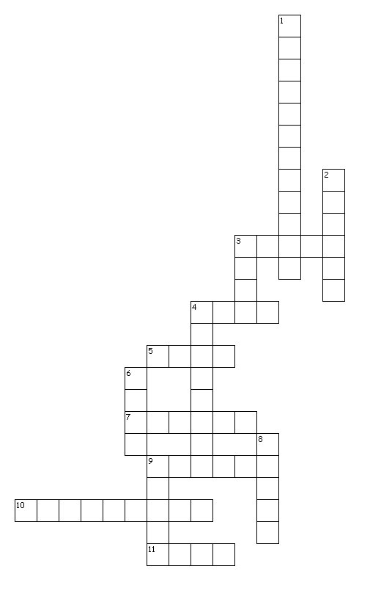
Across
3. naissance
4. Vouloir
5. or
7. prendre sa retraite
9. discours
10. fêter
11. connaître
Down
1. pompiers
2. se rassembler
3. brûler
4. incendie de forêt
6. blesser
8. côte
9. requin
birth
want
gold
retire
speech
celebrate
know
firefighters
gather
burn
wildfire
hurt
shore
shark

Slide 25
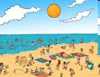
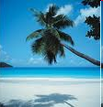
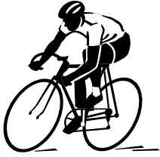
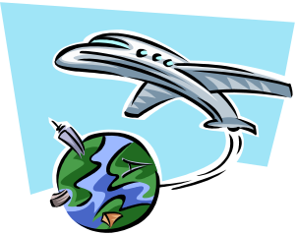

What did you do last summer ?

