Slide 1
ODD JOBS :
QUALITIES REQUIRED?
Idée Sandrine Gand

Slide 2
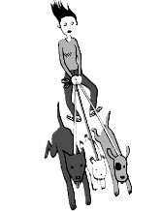
If you want to be a dog walker, you must be strong, responsible, fit and you must be a dog lover.

Slide 3
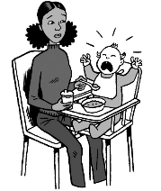
If you want to do some baby sitting, you must be patient, responsible, you must enjoy being with children.

Slide 4
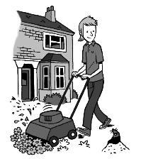
If you want to do some gardening, you must be strong, patient, handy and you have to like working outdoors.

Slide 5
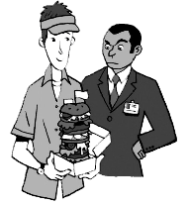
If you want to be a waiter or a waitress, you have to be organized, helpful, kind and you have to enjoy communicating with people.

Slide 6
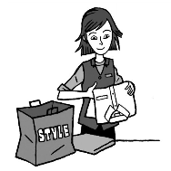
If you want to do some work in a shop for bagging or wrapping, you have to be nice with customers.

Slide 7
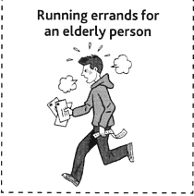
If you want to run errands for elderly people, you have to be organized, helpful and quick.

Slide 8
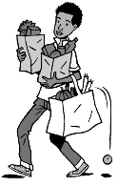
If you want to do some shopping for people, you have to be kind, responsible and strong. And honest!

Slide 9
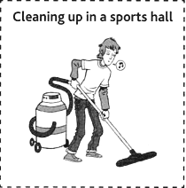
If you want to clean up, you have to be careful and hardworking.

Slide 10
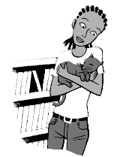
If you want to do some cat sitting, you have to be responsible, patient and you must enjoy being with cats.

